Slide 1
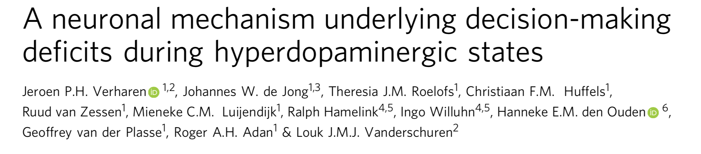

Jessica Chan July 6, 2018 Britt Lab

Slide 2

Overview
Hypothesis
Hyperactivation of VTA neurons interferes with RPE processing and leads to impaired adaptation to reward value dynamics.
What is actually being attenuated, and what is the underlying mechanism?
Impaired decision making is observed in mental disorders that involve hyperdopaminergic states
Some include: substance abuse, mania, and side effects of DA replacement therapy in Parkinson’s patients
This paper focuses on dopaminergic pathways from the VTA to the NAc and mPFC ; mesoaccumbens and mesocortical pathway respectively
DA responses from the VTA correlate with RPE theory, used in value based learning to update decision making policies

Slide 3
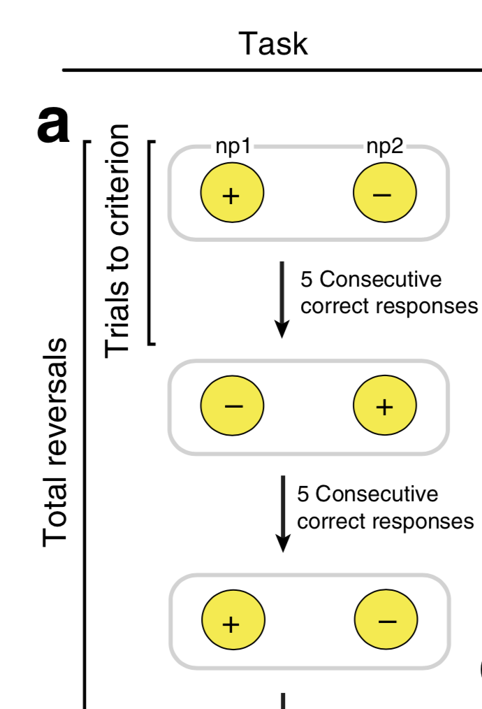
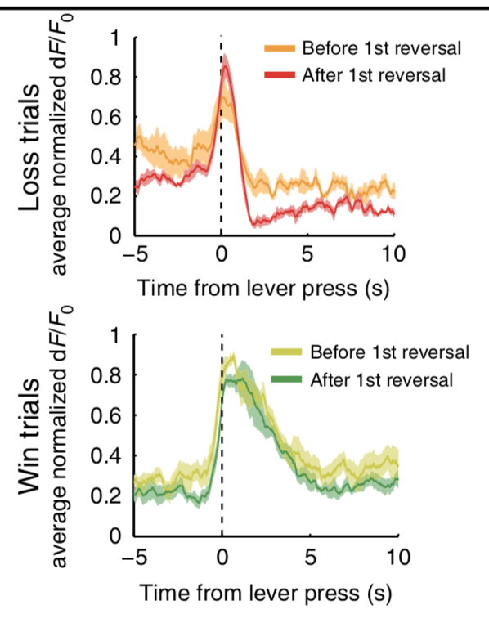
Finding a behavioural output
Reversal Learning Task
Illumination of 2 nose poke holes; one active and one inactive (randomized)
Active hole resulted in sucrose pellet delivery at a corresponding food port
After 5 consecutive correct responses, active and inactive were swapped
150 trials each run
Task’s purpose is to test ability to utilize mechanisms of revaluation and devaluation
In vivo fiber photometry recording of VTA DA neurons shows expected RPE (TH:Cre rats with GCaMP)
Is there an effect of drug induced increase in VTA DA activity?
Rats were given systemic treatment of cocaine and D-amphetamine
Drugs known to be DA neurotransmission enhancers

Slide 4
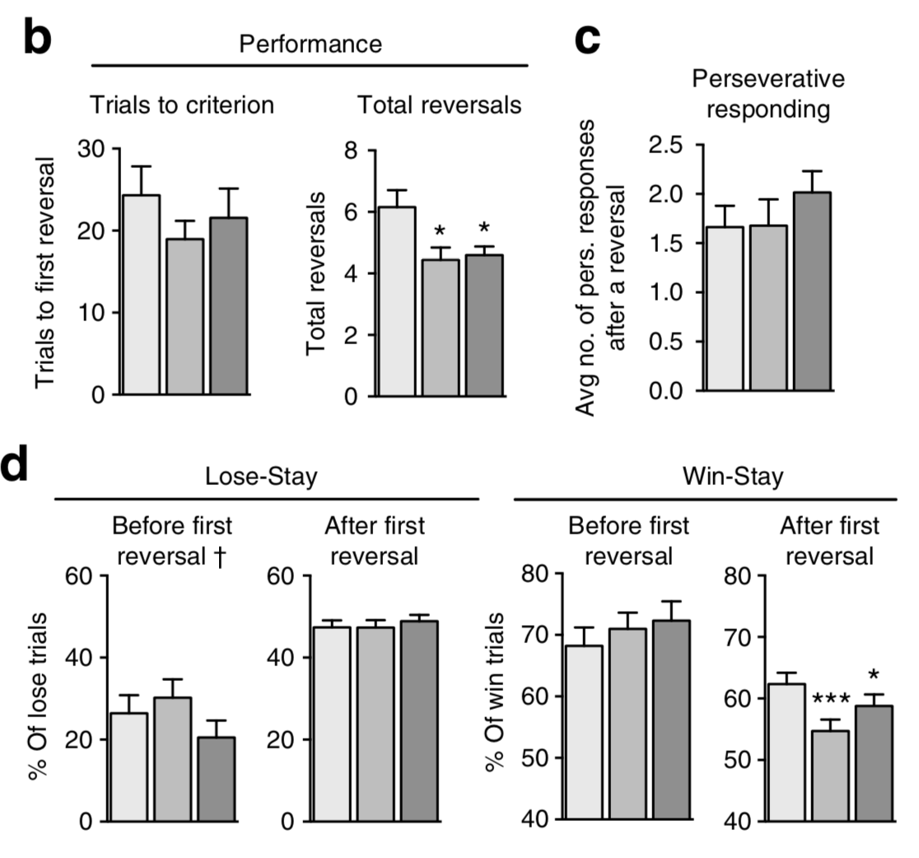
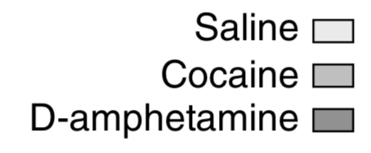
Behavioural analysis
Trials to criterion: # of trials until reversal
Total reversals: # of times port activity reversed
Perseverative responding: avg. responses in previously active hole directly after reversal
Lose-stay behaviour: percentage of consecutive unrewarded nose pokes in the same inactive hole
Win-stay behaviour: percentage of consecutive rewarded nose pokes in the same active hole
Results:
No change in trials to criterion
Suggests no change in initial positive value learning
Decrease in total reversals
Suggests impaired ability to update changing values
No change in perseverative or lose-stay behaviour
Same behaviour as controls – covered in discussion
Decrease in win-stay post-reversal
Suggests attenuated ability in degradation of previously valued nose poke

Slide 5
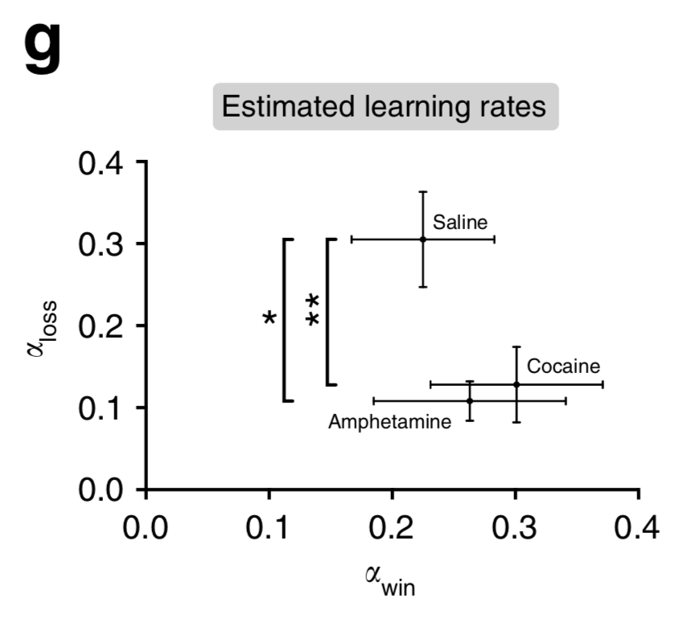
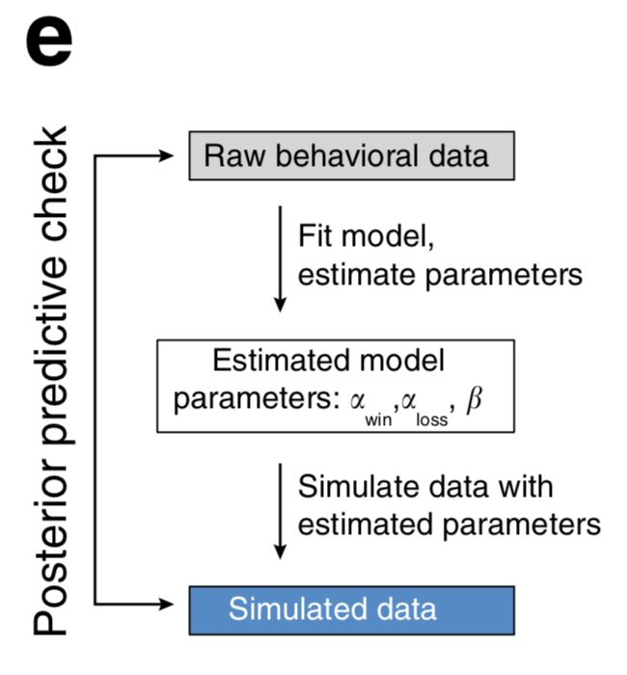
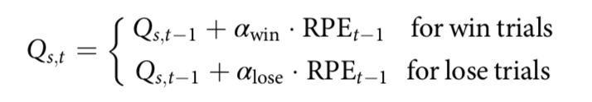
Values for ⍺-win // ⍺-loss extracted by using best fit parameters from raw behavioural data
Modelling observed a strong decrease in ⍺-loss, but no change in ⍺-win
This suggests drug induced overactivity of DA neurons in the VTA interferes with learning from negative RPEs, but not positive
Data Analysis
Fit the raw data to a computational reinforcement learning model using 2 different learning rates describing ability to learn from wins and losses:
⍺-win // ⍺-loss
Extended Q-learning model:
Now we have an idea of what might be changing. Can we localize it to a pathway?

Slide 6
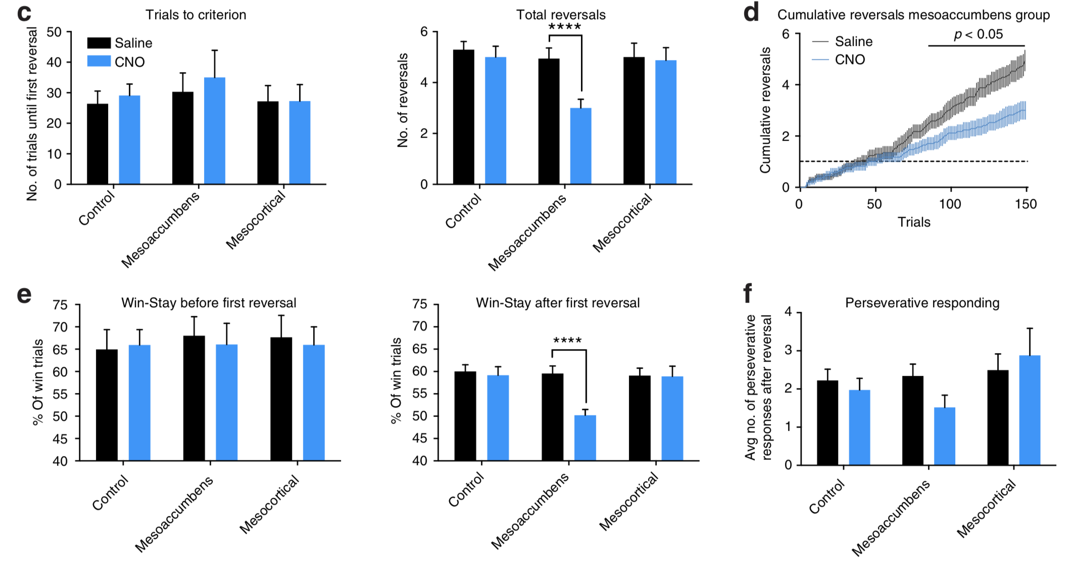
Excitatory DREADD receptor pathway isolation
DREADDs and CNO injection used to cause pathway specific overactivity of DA neurons.
Rats were injected with CNO immediately before testing in the same reversal learning task.
VTA-mPFC:
Same results as sham-operated controls, no effect
VTA-NaC:
Similar result to cocaine and D-amphetamine rats
Which pathway is responsible for the attenuation of negative RPE processing?
VTA-NAc
(mesoaccumbens pathway)
Interestingly, win-stay and lose-stay behaviour are closer to 50%
Results were similar to random choice behaviour
Suggests that both options were positively valued, and stunted ability to devalue allowed values to become similar
Notes:
Interestingly, win stay and lose stay behaviour were both closer to 50% in this manipulation
This suggests that negative processing of the RPE caused by an absent reward where there was supposed to be reward was not incorporated into decision making policy – similar to random choice behaviour
Both options were considered good, and so decision making reflected that equalized valuation of both ports

Slide 7
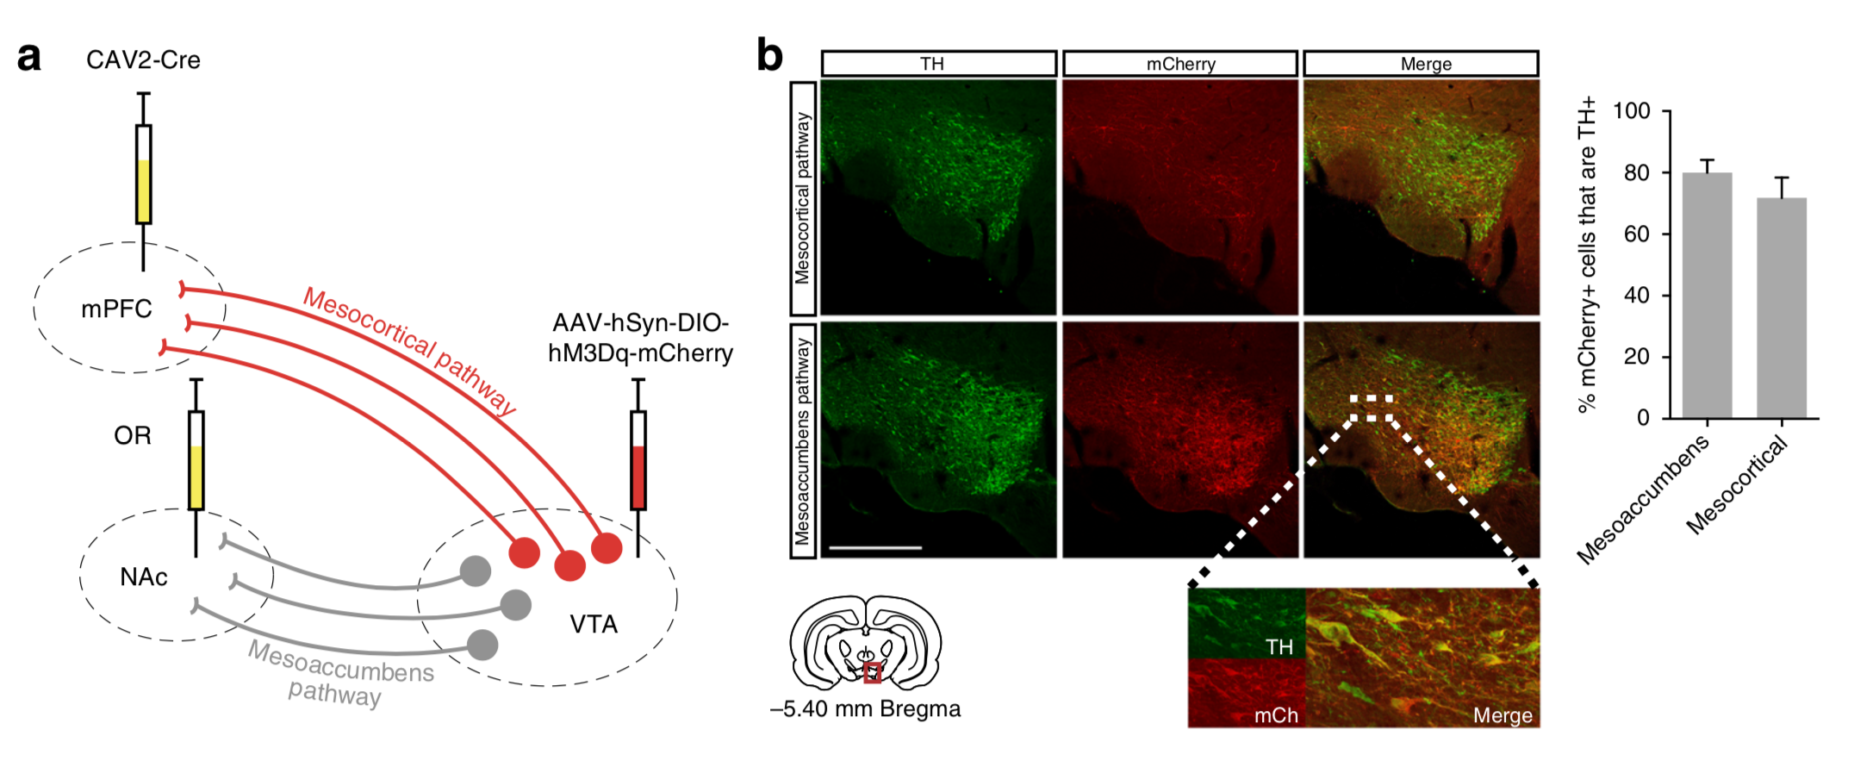
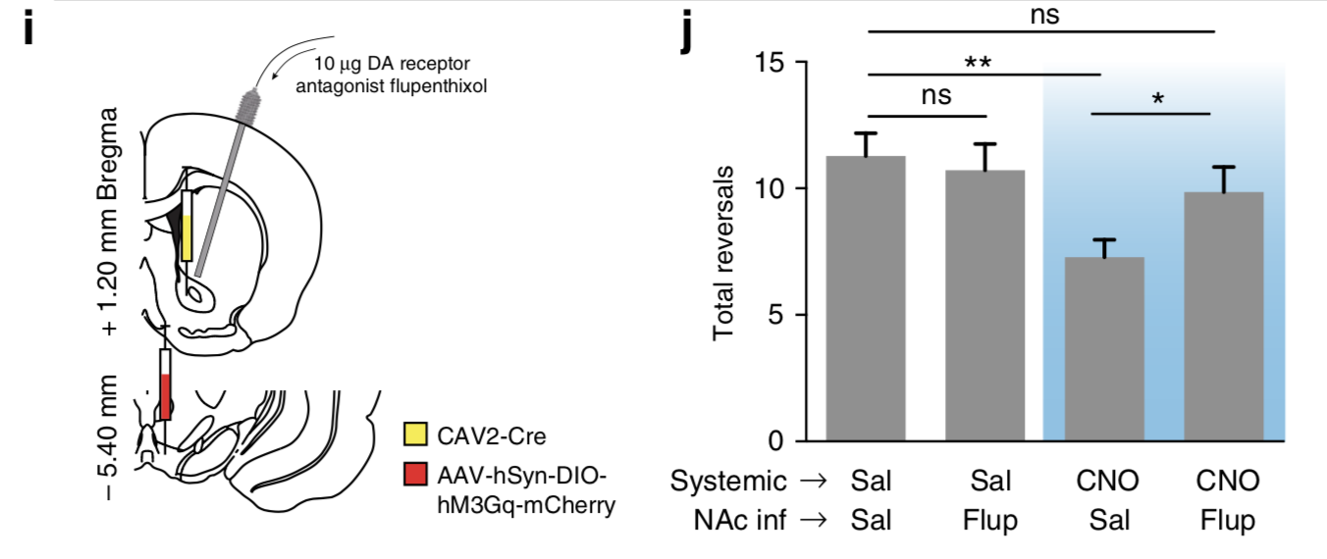
Dopamine confirmation
Histology reveals ~75% of transfected neurons stained for both TH and mCherry-DREADD
Infusion of ⍺-flupenthixol (DA receptor antagonist) in the NAc blocked effect of DA overactivity
DA receptor overactivity in the NAc is necessary for the effect
Notes:
Because the transfection procedure was not TH:Cre, non specific
These tests were done to confirm the nature of the neurons involved as DAergic
Retrograde virus to infect pathways from NAC or mPFC to the VTA specifically
DREADD and cherry fluorescence delivered for later histology
80% of transfected neurons in mesoaccumbens
72% of transfected neurons in mesocortical
^^ above were positive for Tyrosine hydroxylase, an enzyme that makes L-Dopa

Slide 8
Interim Conclusion
Dopamine neuron overactivity causes attenuated ability to process negative RPEs and update value based decision making policies ; impaired reversal learning
Processing of positive RPEs is not affected
This effect is primarily mediated by DA neurons of the VTA-NAc pathway
More specifically, the effect is mediated by DA receptor activity in the NAc, as it can be blocked by applying DA receptor antagonists in the NAc
Does this attenuation of RPE processing affect ability to process reward probability?

Slide 9
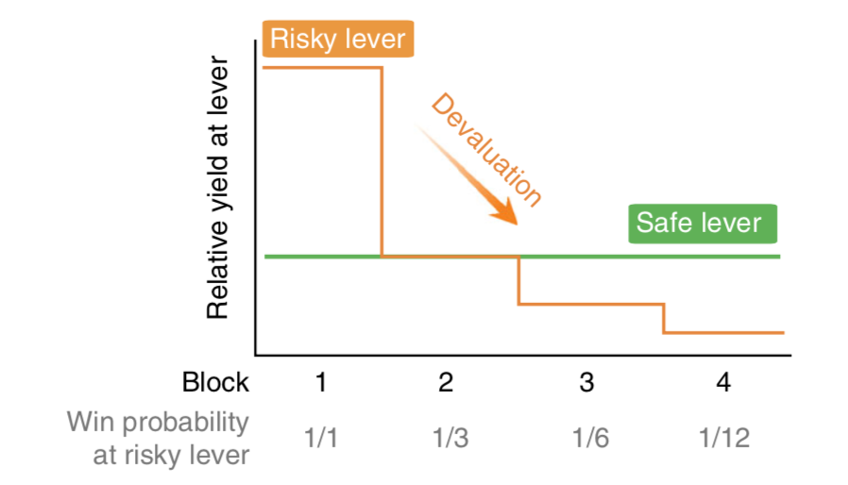
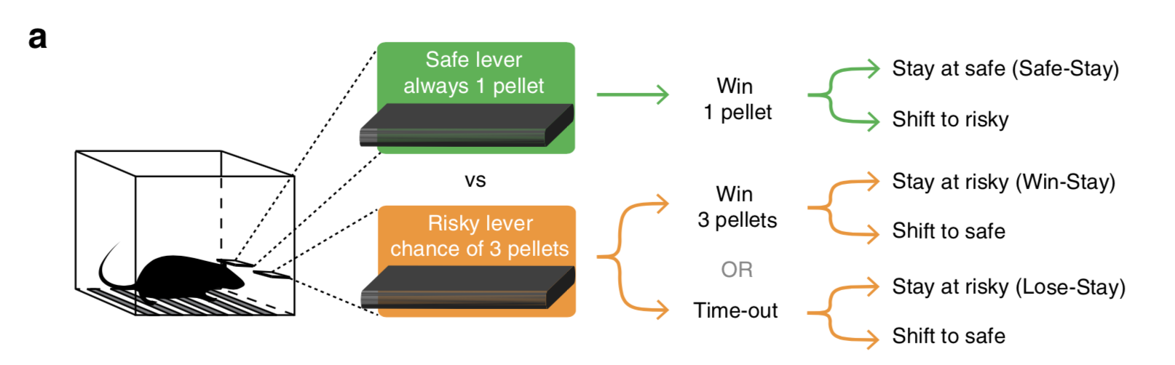
Probabilistic discounting task
Choose between a safe lever and a risky lever
Risky lever gives a larger reward compared to the safe lever
First round risky lever always delivers food
Risky lever win probability goes down as rounds go
Task purpose is to test ability to discount value of the risky lever and adapt behaviour accordingly
Same DREADD chemogenetic animals used to overactivate either the mesoaccumbens or mesocortical pathway
Notes:
Increase in lose stay or decrease in win stay behaviour does not reflect poor choice behaviour
This is because lose stay behaviour may give the same amount of sucrose as. A shift to the safe lever depending on the odds in the trial

Slide 10
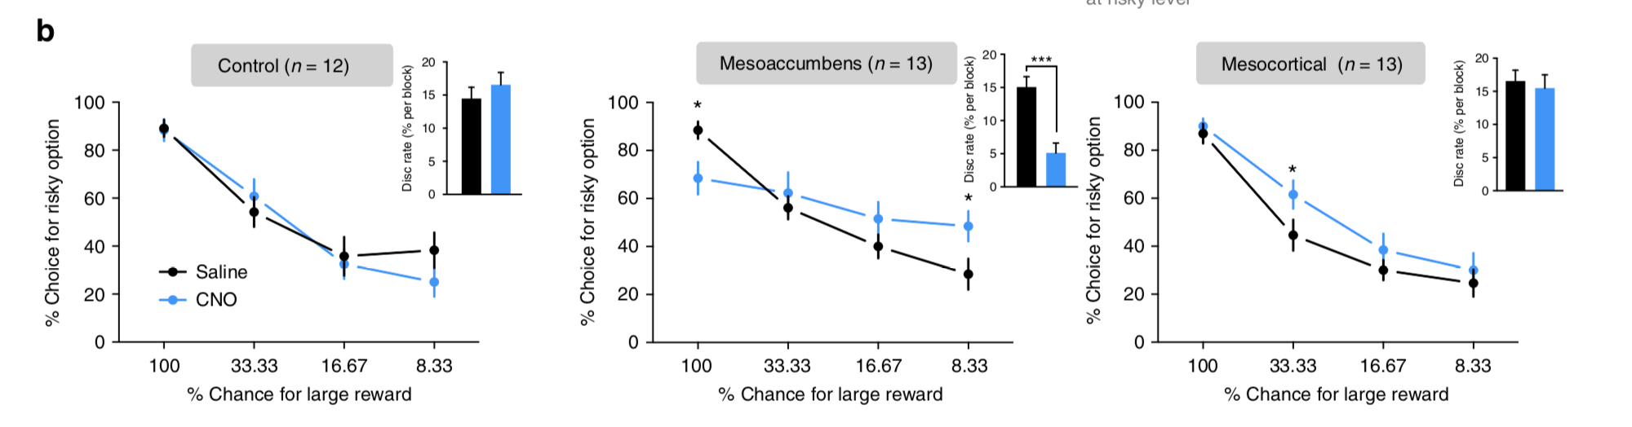
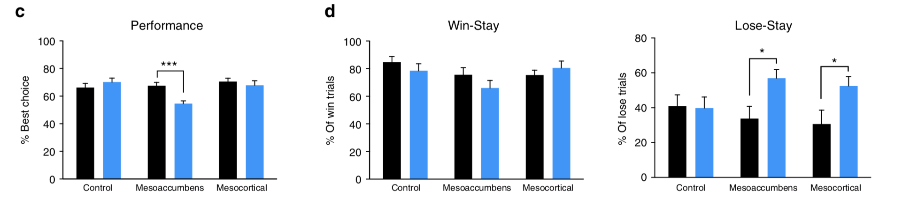
Results:
Mesoaccumbens activation:
Significant reduction of slope of discounting curve
Significant increase in lose-stay behaviour
Mesocortical activation:
Increase in risky lever presses in second block only
Second block has equal yield probability ; 1/3 chances for 3 pellets and 1/1 chances for 1 pellet
Significant increase in lose-stay behaviour
This suggests the rats were unable to adapt declining outcome of the risky lever with mesoaccumbens activation
Reduced choice of the risky lever in the first round may suggest a deficit in determining the safe lever as a loss relative to the risky lever
Notes:
Decreased risky lever choice in the first block and increased risky lever choice in the last block resulting in significant reduction of slope of discounting curve
Second block notably has the same reward yield according with availability
No effect on win stay behaviour

Slide 11
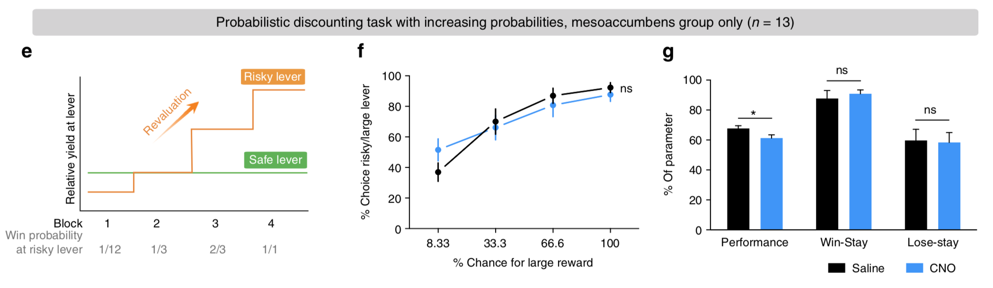
Negative RPE confirmation
Same task with increasing probabilities instead of decreasing at the risky lever
Testing to see if positive RPE processing may be affected
No major change in risky lever choice between blocks
Observed higher preference for the risky lever despite lower probability of reward in first block, likely due to reduced ability to devalue the outcome of the risky lever
Activation of both pathways caused no significant changes in behaviour relative to controls ; no change in ability to process and adapt to positive RPEs

Slide 12
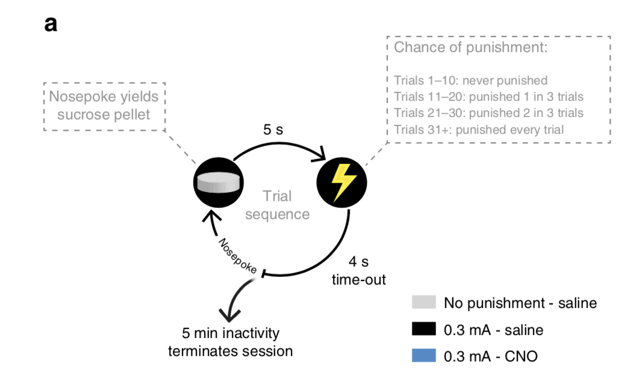
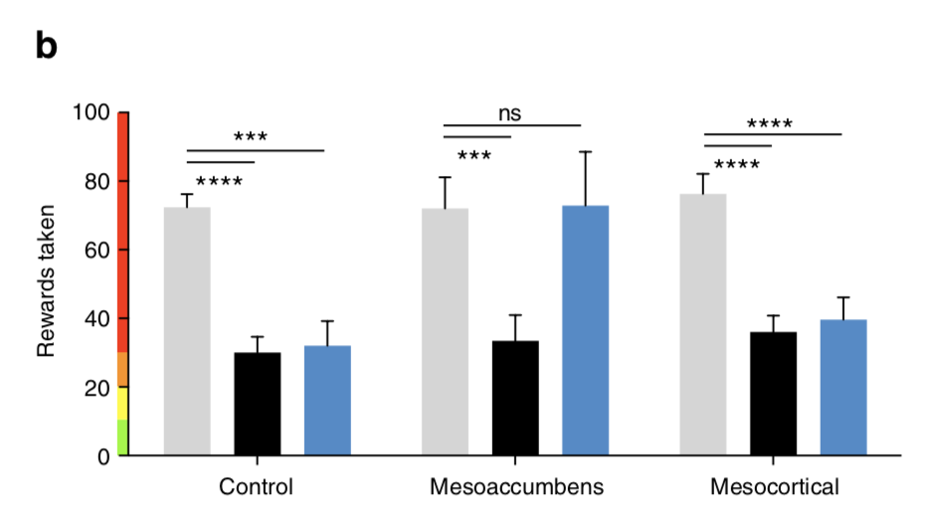
Punishment insensitivity
Novel punishment task
Reward taking was paired with inescapable foot shock with increasing probability
Task meant to devalue reward by pairing with aversive stimuli
Results:
Mesoaccumbens activity abolished reduction in responses induced by punishment ; took as many rewards as non punishment conditions
Expected decrease in sucrose consumption persisted with sham control groups as well as with mesocortical activation groups
Suggests a pathway specific effect of punishment insensitivity likely caused by impaired ability to learn reduced value from negative RPEs

Slide 13
Interim Conclusion
Dopamine neuron overactivity causes attenuated ability to process negative RPEs and update value based decision making policies
Ability to adapt to decreasing reward probability significantly diminished
Punishment sensitivity is robustly diminished
Processing of positive RPE is not affected
Ability to adapt to increasing reward unaffected
This effect is primarily mediated by DA neurons of the VTA-NAc pathway
What is the underlying mechanism of the deficit?

Slide 14
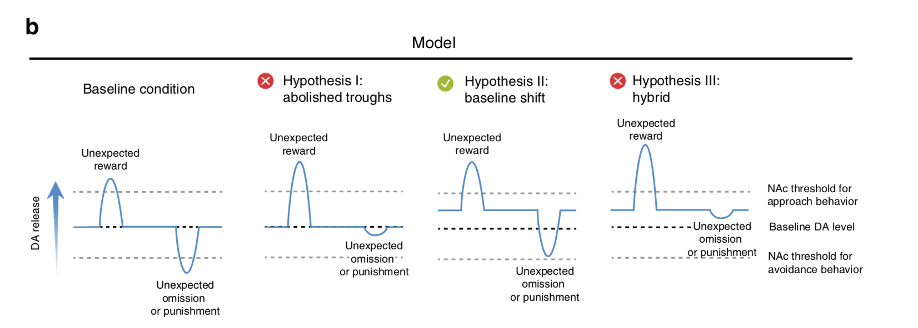
Proposed Hypotheses
Hyperactivity mesoaccumbens DA neurons leads to impaired encoding of negative RPE troughs
Hyperactivity shifts baseline NAc DA levels, preventing negative RPEs from exceeding the usual threshold needed for learning to occur
Combination of both
1.
2.
3.
Notes:
Abolishes the trough of the negative RPE
Basline shift in RPE signaling , negative RP does not reach lower threshold necessary for learning
Combination of both

Slide 15
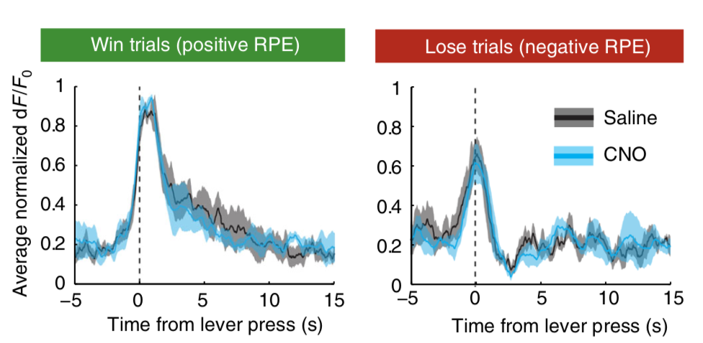
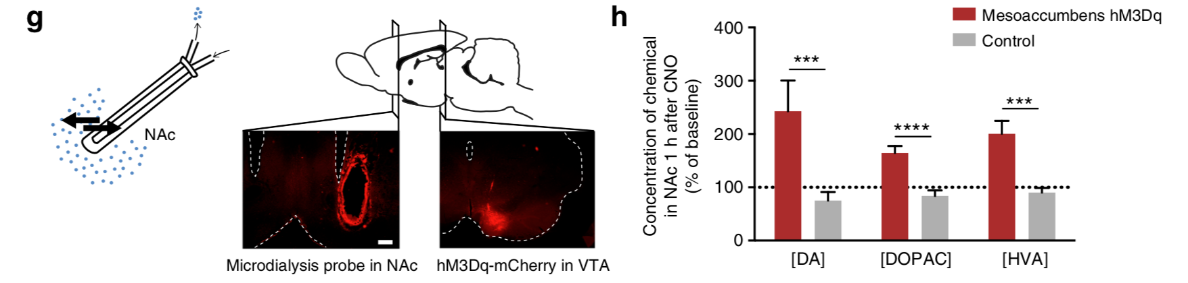
Negative RPE encoding is not affected // Baseline DA elevation observed
Animals co-injected with DREADD and GCaMP then tested in reversal learning task
In vivo recording of VTA neurons shows no significant difference in RPE encoding
RPE encoding is not impaired by hyperdopaminergic states
Microdialysis used to measure extracellular concentrations of DA and its metabolites in the NAc after chemogenetic stimulation
NAc levels of DA and metabolites were elevated after 1 h of CNO injection compared to controls
Suggests that elevated tonic levels of DA in the NAc lead to impairments in negative RPE processing
Notes:
so

Slide 16
Proposed Hypotheses
Hyperactivity mesoaccumbens DA neurons leads to impaired encoding of negative RPE troughs
Hyperactivity shifts baseline NAc DA levels, preventing negative RPEs from exceeding the usual threshold needed for learning to occur
Combination of both
1.
2.
3.
Notes:
Abolishes the trough of the negative RPE
Basline shift in RPE signaling , negative RP does not reach lower threshold necessary for learning
Combination of both

Slide 17
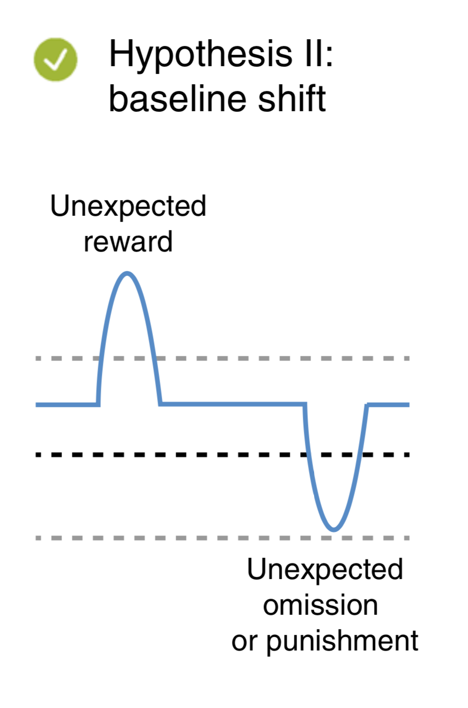
Findings
RPE recordings from the VTA showed similar deviations from baseline DA activity during reversal learning tasks
Supported by microdialysis of the NAc that showed elevated concentrations of dopamine and its metabolites at baseline when chemogenetically manipulated
Suggests negative RPE processing is mediated by DA receptors in the NAc that store a typical baseline and typical threshold RPEs must exceed for learning

Slide 18
Conclusion
Hyperactivation of the VTA leads to decision-making deficits by impairing negative feedback learning through overstimulation of NAc DA receptors
Impaired reversal learning
Diminished ability to adapt to decreasing reward probability
Punishment sensitivity is robustly diminished
This effect is primarily mediated by a temporary shift in tonic DA levels in the NAc causing impaired processing of negative RPEs
This results in attenuated ability to negatively asses risk and punishment during states of hyperdopaminergic tone
It is speculated that hyperdopaminergic states in people are associated with reckless and overconfident behaviour, and this may be a neuronal mechanism behind the effect
Questions?

Slide 19
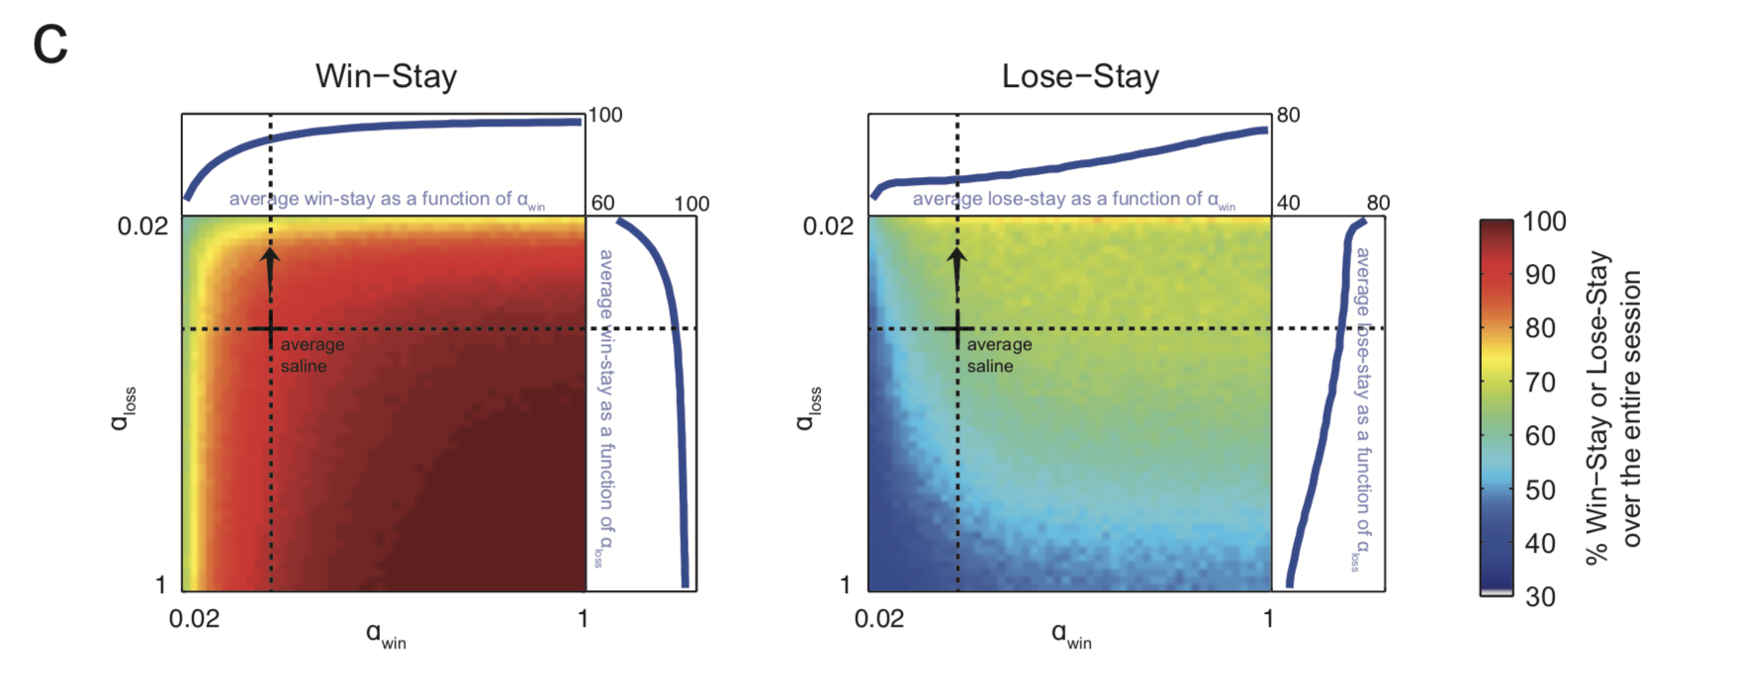
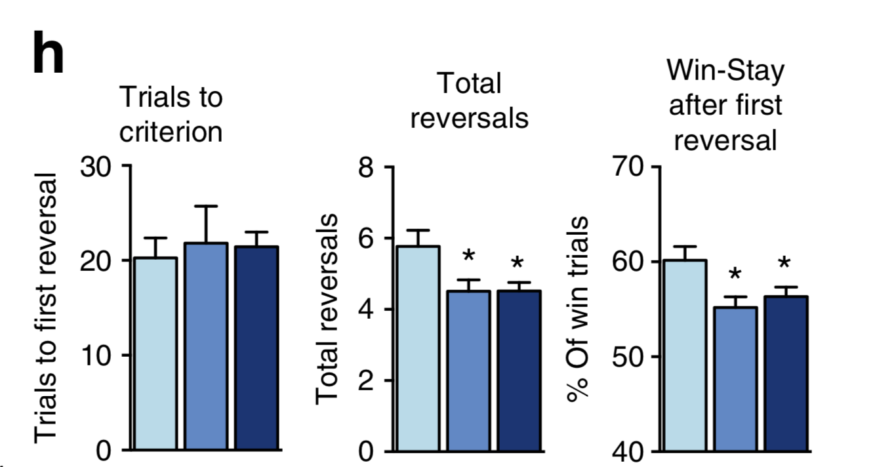
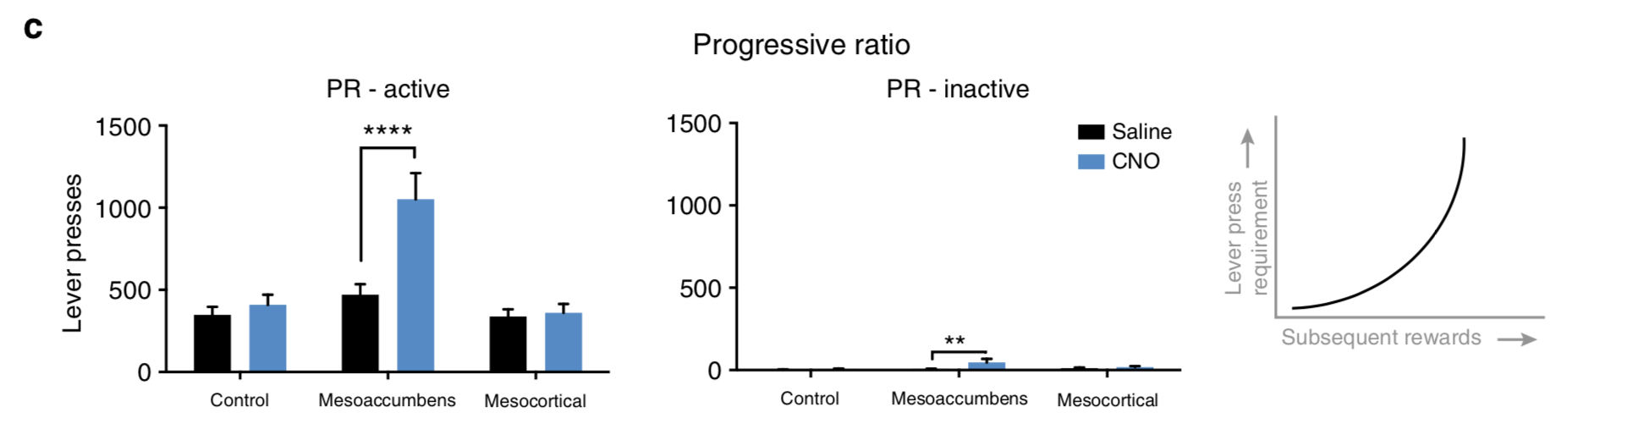
Discussion
Why was lose-stay behaviour unaffected in reversal learning? Paper argues that modelling drug induced changes in lose-stay behaviour along the ⍺-loss axis shows a smaller change in slope of increase in comparison to significant change in slope of decreasing win-stay behaviour.
Mesoaccumbens activation caused increase in operant responding under a progressive ratio schedule, typically interpreted as increased motivation. Paper argues that it is actually due to attenuated ability to devalue lever relative to effort. Is this believable?

Slide 20
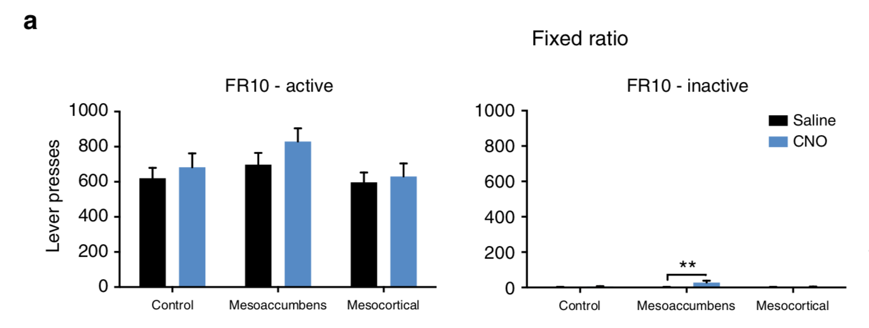
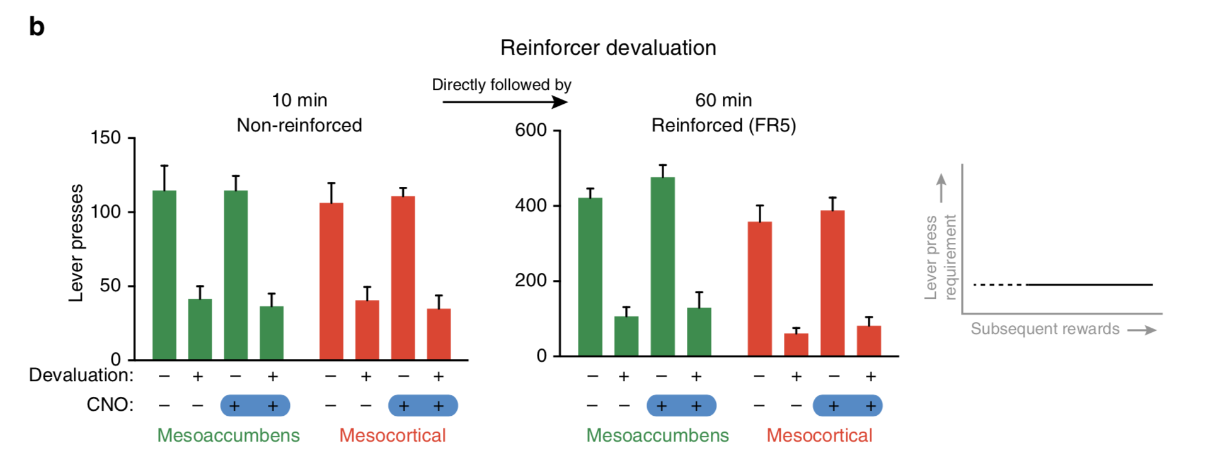
Extras
FR10 schedule:
DREADD activation of pathways had little to no effect on FR10 schedule behaviour
Observed modest increase in inactive lever presses in mesoaccumbens activation
Suggests that absolute reward value was not changed
Extinction and devaluation:
Devaluation = pre-feeding with reward
Extinction session: no consequence in lever press
No effect of pathway activation in devaluation task
Suggests responding remained goal directed and value of reward was not affected by activation
Extinction session

Slide 21
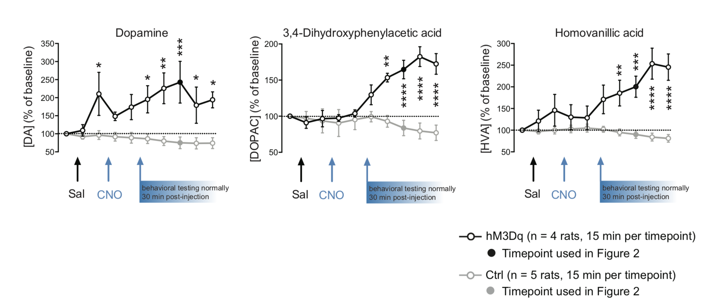
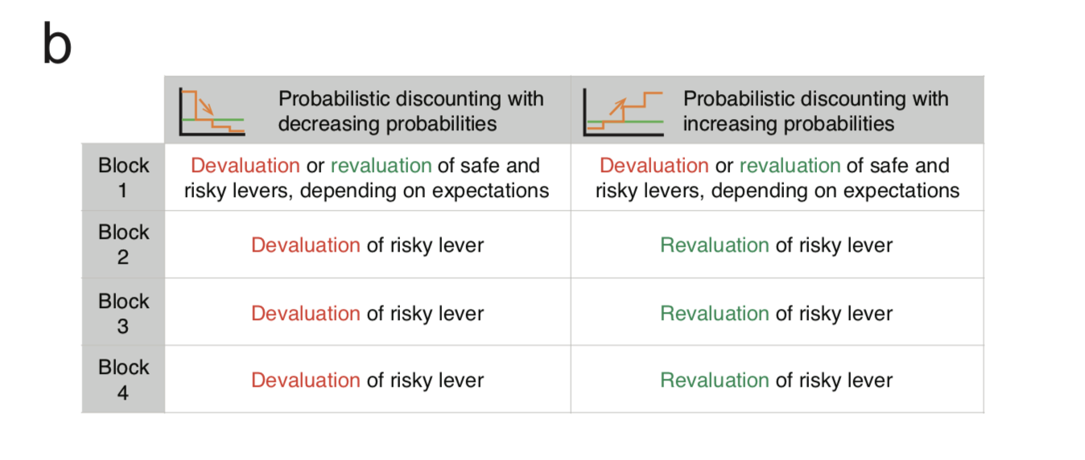
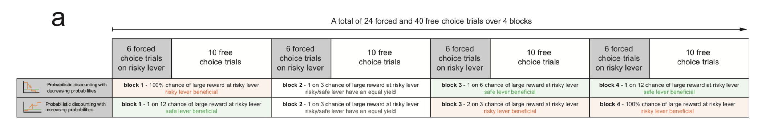
More extras
Concentration of NAc DA and metabolite over time
Structure and analysis of probabilistic discounting tasks
Shows which levers are more beneficial in each reward probability

